Slide 1

ShelterSight Toronto
Optimizing Homeless Shelter Operations in Toronto
By Nida Copty, Emily Nguyen, Tom Nguyen, India Tory
Notes:
India

Slide 2




Table of Contents
Introduction
Methods
Results
Discussion
Notes:
India

Slide 3

Introduction
Notes:
India

Slide 4
25,000 to 35,000
people are homeless on any given night in Canada
Notes:
India
25,000 to 35,000 people are homeless on any given night in Canada
Around 9000 are in Toronto alone

Slide 5
The annual cost of homelessness to society is
$ 7B
Notes:
India
Each year, homelessness imposes a staggering $7 billion cost on Canadian society.
This figure isn't just a number—it represents the immense human, social, and economic challenges that stem from not having a place to call home.

Slide 6
The Canadian Government is investing
$ 2.2B
over 10 years to expand funding for homelessness
Notes:
India
In response to this crisis, the Canadian government is investing $2.2 billion to improve shelters and services for the homeless.
This substantial investment underscores the commitment to tackling homelessness but also highlights the need for strategic, data-driven approaches to ensure this funding is used effectively.

Slide 7
Problem Statement
To enhance the efficiency of Toronto's homeless shelter operations through the development of a machine learning model designed to accurately anticipate fluctuating shelter demands driven by dynamic urban challenges.
Notes:
India
Through our research, we came up with the following problem statement to guide this project…
Problem statement:
To enhance the efficiency of Toronto's homeless shelter operations, we are developing a machine learning model designed to accurately anticipate fluctuating shelter demands driven by dynamic urban challenges.

Slide 8
Goals
Bridging AI and Decision-Making in Shelter Management
To develop a user-friendly, reliable forecasting model that integrates seamlessly into the decision-making processes of shelter operations.
Empowering Shelter Operations with Predictive Analytics
To equip shelter operators with predictive tools that can anticipate periods of high demand and adjust resource allocation accordingly.
Notes:
India
Our first goal is to bridge the gap between AI and decision-making in shelter management
Goal: Develop a user-friendly, reliable forecasting model that integrates seamlessly into the decision-making processes of shelter operations.
Impact: This model is designed to make existing data actionable, providing shelter managers with timely insights that support critical operational decisions, thus overcoming the traditional barriers between AI technology and practical implementation.
Our second goal is to empower shelter operations with predictive analytics
Goal: Equip shelter operators with predictive tools that can anticipate periods of high demand and adjust resource allocation accordingly.
Impact: Enhance the responsiveness of shelter services to the dynamic needs of the homeless population, contributing to more stable and supportive shelter environments.

Slide 9




Our Team
Nida Copty
Thomas Nguyen
Emily Nguyen
India Tory
Notes:
India
Before we begin, I wanted to quickly introduce our team
We are the Compassionate Coders, made up of four Engineering Science students from the University of Toronto

Slide 10

Methods
Notes:
Now, we will be walking you through the methods used for this project

Slide 11
Data
Notes:
India
First, we will be talking about data

Slide 12
Data
Daily Shelter & Overnight Service Occupancy & Capacity
Government of Canada Historical Climate Data
New Housing Price Index (Monthly)
Person in Crisis Calls for Service Attended Open Data
Unemployment Data
Notes:
India
Throughout this project, we explored a wide range of datasets
We looked into:
shelter service occupancy and capacity data
Climate data
Housing price data
Crisis call data
And unemployment data

Slide 13
Dataset Selection
Daily Shelter & Overnight Service Occupancy & Capacitance by the City of Toronto
Program ID
Occupancy Date
Organization ID
Location ID
Location Postal Code
Location City
Sector
Program Model
Program Area
Capacity Type
Unavailable Beds/Rooms
Occupancy Rate Beds/Rooms
Notes:
India
After further exploration, we learned that the data shelter and overnight service occupancy and capacitance dataset, by the city of toronto, would be to focus for this project
This dataset included various categories that were useful to our application, such as organization ID, postal code, and capacity type

Slide 14
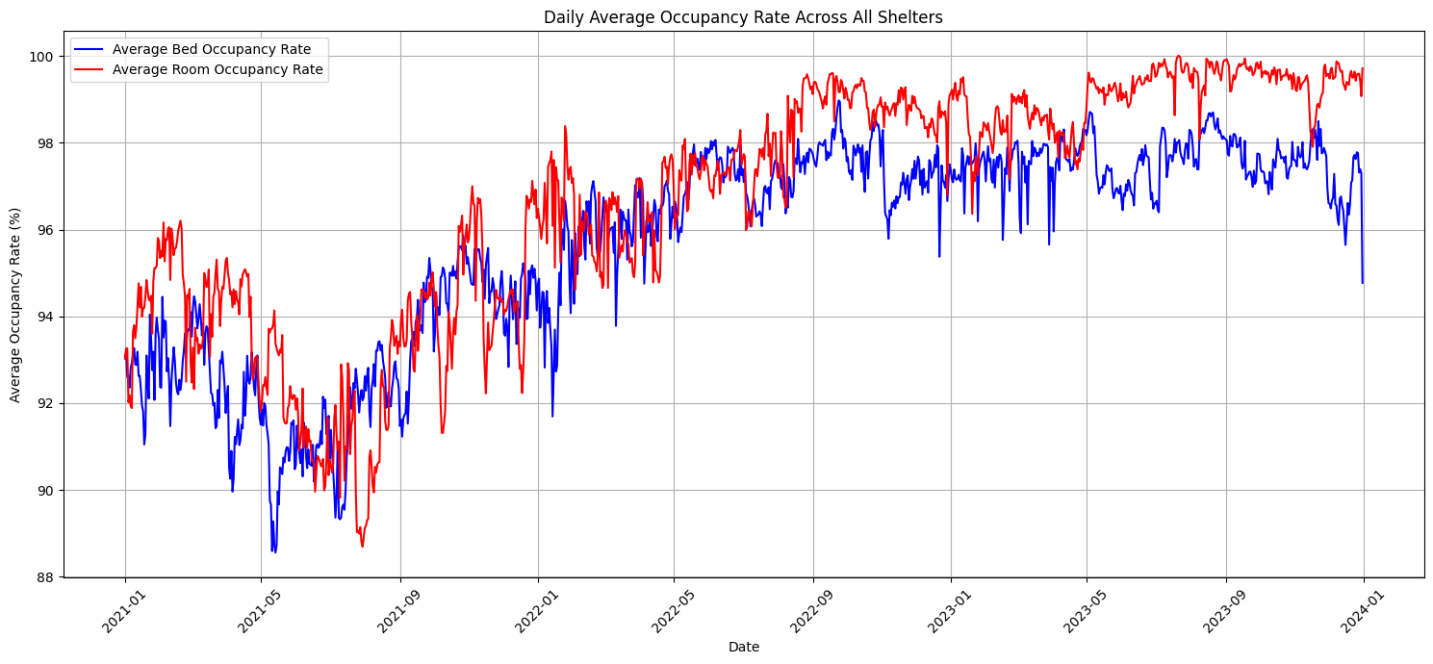
Data Visualization
Figure 1: Daily Average Occupancy Rate Across All Shelters
Notes:
India
Through simple data visualizations, we tried to understand basic trends
Here, we can see how nightly occupancy has been on a fairly steady incline since July of 2021

Slide 15
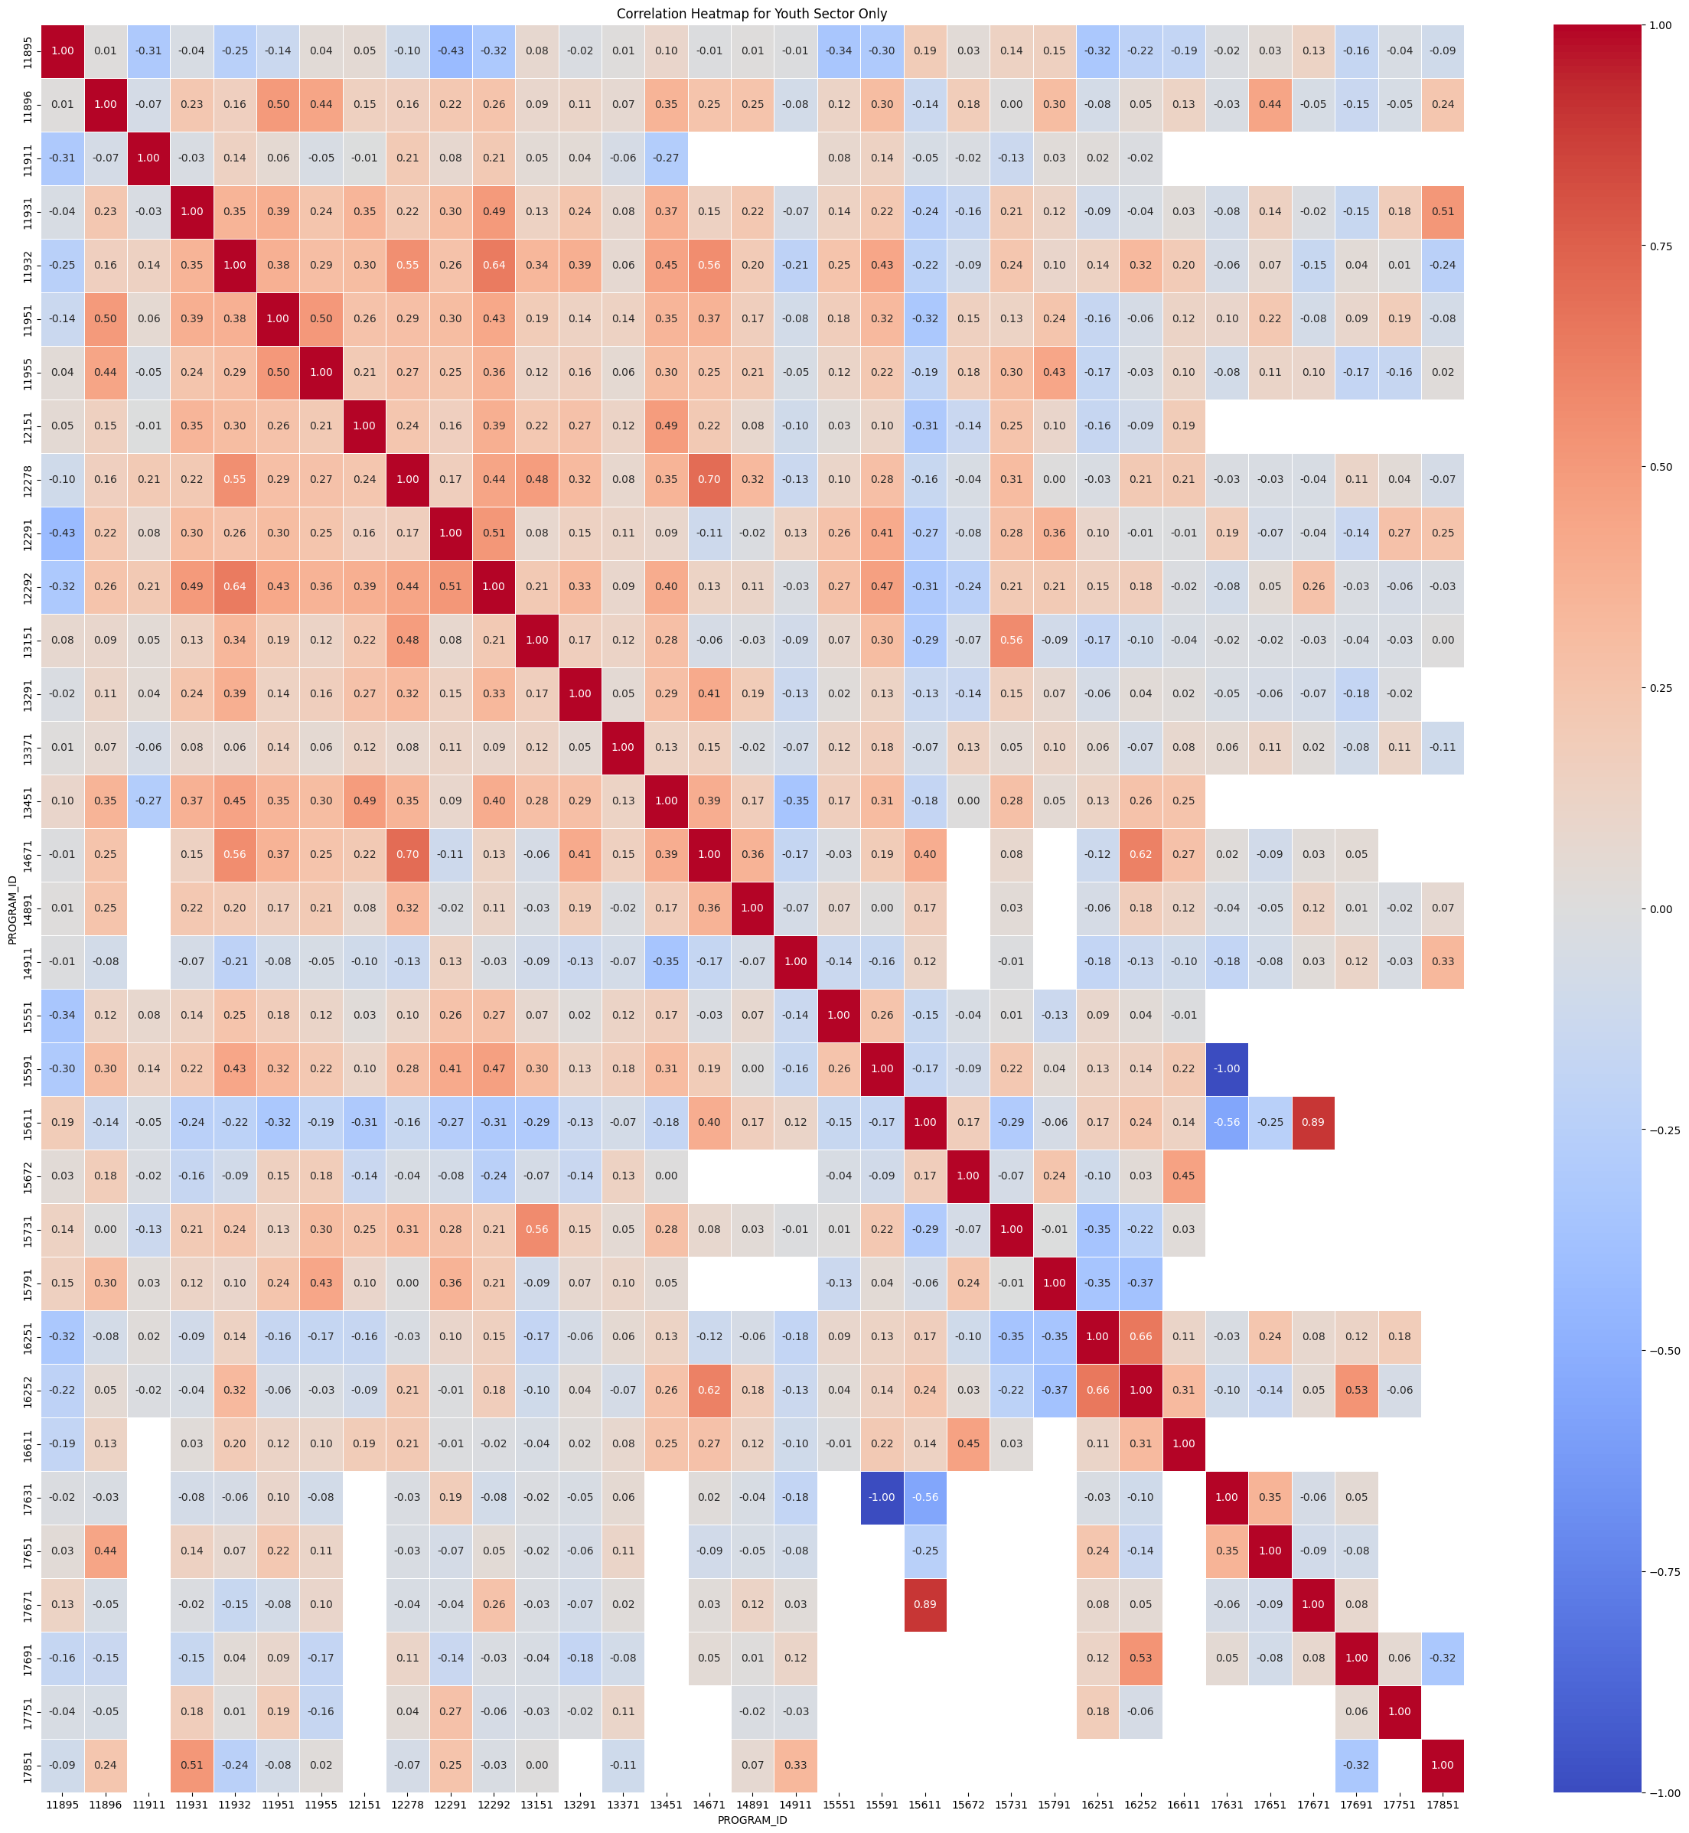
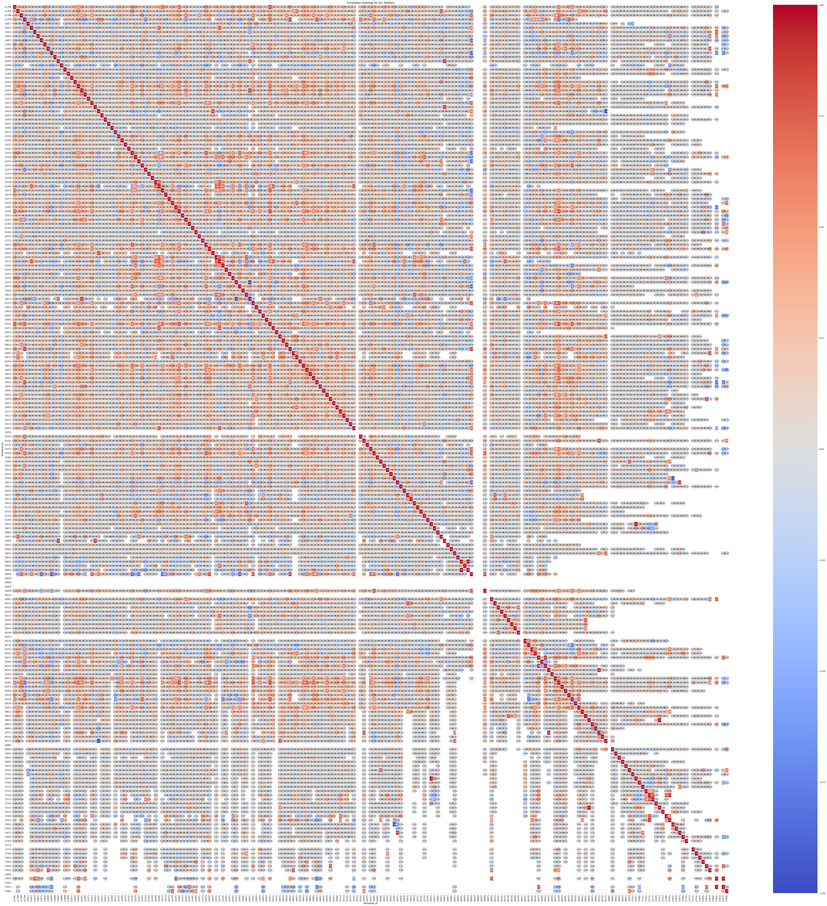
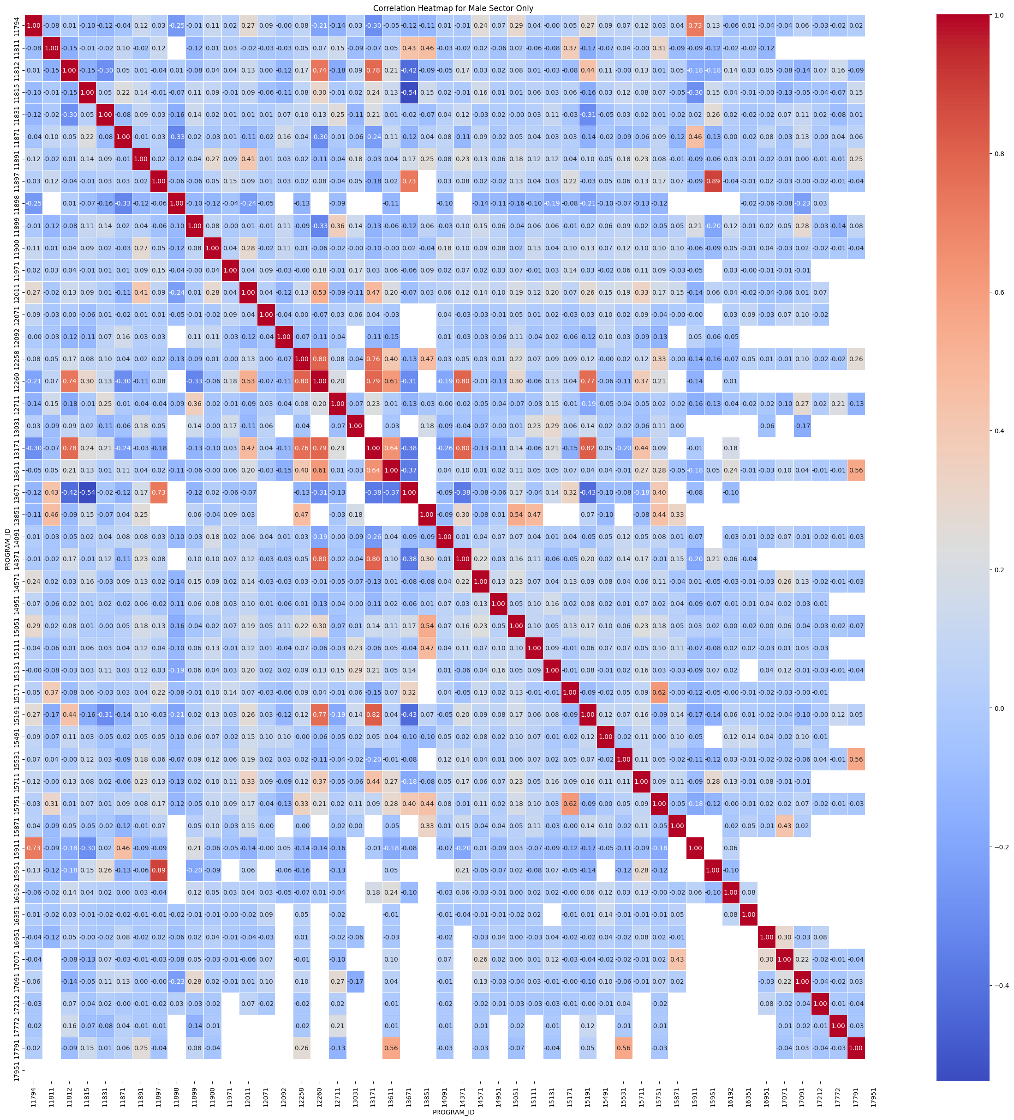
Data Visualization
Figure 3: Correlation Heatmap for All Shelters
Figure 4: Correlation Heatmap for Only “Youth” Shelters
Notes:
India
We also tried to understand relationships in the data
Although it is difficult to make out the specifics of these heatmaps, the point of this analysis was to spot areas of red (where there is correlation between the occupancies)

Slide 16
Baseline Models
Notes:
Nida
Before we dive into our proposed model, I will talk about some baseline models we used as a starting point.

Slide 17
Baseline Model Performance
Random Forest Regression Model
Autoregressive
Model
Root Mean Squared Error: 7.04
Mean Absolute Error: 2.59
Root Mean Squared Error: 4.12
Mean Absolute Error: 16.96
Prophet Model
(5-Day Horizon)
Root Mean Squared Error: 13.66
Mean Absolute Error: 13.44
Notes:
Nida
These baselines were carefully selected to ensure a robust evaluation of our proposed methodology.
This comprehensive benchmarking provides a clear context for assessing the strengths and potential improvements of our proposed solution
As a starting point, we used three baseline models as a benchmark for the performance we expect from our proposed solution. The models we selected were Random Forest Regression, Autoregression, and the Prophet model. Random forest model builds multiple decision trees from random subsets of data and averages their predictions. Autoregression is a type of linear model used in time series forecasting that predicts future values based on past values. Prophet is a model developed by Facebook and is designed to forecast time series data. These baselines were carefully selected due to their strengths in time series analysis providing a clear context for assessing the strengths and potential improvements of our proposed solution.

Slide 18
Model Overview
Notes:
Nida
Now, I will give a quick overview of our proposed model

Slide 19
Two-Step Methodology
1
2
Long Short-Term Memory for Initial Demand Forecasting
Forecast Adjustment Based on Data Features and Correlation
Notes:
Nida
Through our research and discussions with mentors here at BorealisAI, we came up with a two step methodology
FIRST, we use long short-term memory to forecast the demand
THEN, we adjust the forecast based on correlations we identified in the dataset
Through our collaborative research and insightful discussions with mentors at BorealisAI, we have developed a two-phase methodology. Initially, we employ Long Short-Term Memory (LSTM) networks to forecast shelter demands, due to their proficiency in handling sequential data. Then, we refine these forecasts by incorporating adjustments based on correlations identified within the dataset, enhancing the accuracy of our predictive model.

Slide 20
Long Short-Term Memory
What is LSTM?
LSTM is an advanced recurrent neural network (RNN) architecture
Uses a unique structure of gates that regulate the flow of information
Why LSTM for Forecasting Shelter Demand?
Handling sequential data
Adaptability to time series forecasting
Robustness to data variability
Dynamic response to external factors
Notes:
Nida
To provide background before we get into the more technical portion, we wanted to give a quick background on long short-term memory
LSTM is an advanced recurrent neural network architecture that makes them capable of learning long-term dependencies in sequence prediction problems.
They use a unique structure of gates that allows them to selectively remember or forget patterns.
We chose the LSTM for this purpose for the following reasons:
Handling Sequential Data: Shelter demand is inherently sequential and influenced by previous events. LSTMs excel at tasks where current events are dependent on the history of past events.
Adaptability to Time Series Forecasting: LSTMs have proven effective in time series forecasting, which aligns well with predicting fluctuations in shelter usage based on historical data.
Robustness to Variability in Data: LSTMs are robust to the noise and variability in usage data, helping to produce more accurate and reliable demand forecasts.
Dynamic Response to External Factors: They can integrate and respond dynamically to external variables such as weather conditions, economic shifts, or policy changes, all of which affect shelter demand.
To provide background before we get into the more technical portion, we wanted to give a quick background on long short-term memory. So what are Long-Shor-Term Memory also known as LSTM models? LSTM is an advanced recurrent neural network architecture that makes them capable of learning long-term dependencies in sequence prediction problems. They use a unique structure of gates that allows them to selectively remember or forget patterns. The strengths of LSTM model that applies to our task include its ability to handle sequential data, Adaptability to Time Series Forecasting, Robustness to Variability in Data and Dynamic Response to External Factors.

Slide 21
Model Construction
Notes:
Now, we will discuss these two components and how we built them in more detail

Slide 22
Model Workflow
Data Collection
Data Pre-processing
Clustering by Location
LSTM Model Training
Feature-Based Adjustment
Prediction Output
1
2
3
4
5
6

Slide 23
LSTM Iterations
Univariate LSTM
for Combined City Average Forecast
Multivariate LSTM
for Combined City Average Forecast
Geospatial Multivariate LSTM
for Individual Shelter Predictions
Moderate forecasting performance for nightly city average
Weak forecasting performance for individual shelters
Notes:
We developed various iterations of the LSTM
First, we made a univariate LSTM that predicted the overall city average occupancy rate
Next, we built a multivariate LSTM that also predicted the overall city average occupancy rate
These two models had moderate forecasting performance for nightly city average BUT weak forecasting performance for individual shelters
Finally, we came up with the idea of a geospatial multivariate LSTM for individual shelter predictions

Slide 24
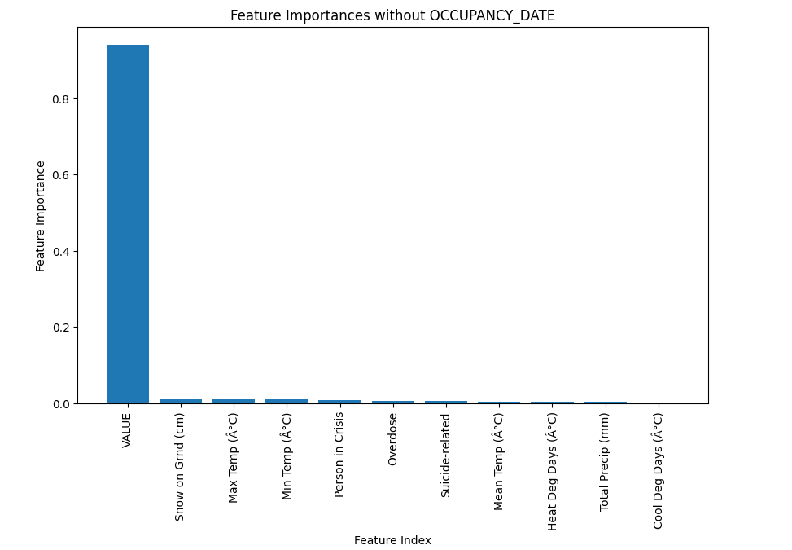
Feature Importance
Used random forest regression model
Determined Gini importance of each feature
Narrowed down to 4 features to compare against
New Housing Price

Slide 25
Geospatial Multivariate LSTM
Clustering
Feature Grouping: apply clustering algorithms to categorize shelters
Dimensionality Reduction: use clustering to reduce the complexity of the data
Enhanced Accuracy: improve accuracy and specificity of forecasts
Model
Architecture: utilizes multiple stacked LSTM layers and fully connected layers
Sequential Data Processing: batch-first approach to predict based on historical context
Flexible and Scalable: adaptable for varying input sizes and grouping schemes
Notes:
We found that there was correlation in the occupancy rate based on the location of the shelter
This gave us the idea to use geospatial multivariate lstm was designed to consider location based grouping of shelters
This clustering of shelters based on their location allowed us to reduce the dimensionality and complexity of the data while improving the accuracy and specificity of our forecasting
The model design is….
Complex Architecture: Utilizes multiple stacked LSTM layers to capture temporal dependencies, complemented by fully connected layers for output processing, enhancing the model's ability to handle sequential data effectively.
Sequential Data Processing: Employs a batch-first approach in LSTM layers, initializing hidden and cell states to zero, and processes data sequentially to accurately predict based on historical context.
Flexible and Scalable: Designed to be adaptable with varying input sizes and configurations based on different data grouping schemas, allowing the model to be scalable and applicable across various forecasting scenarios.

Slide 26
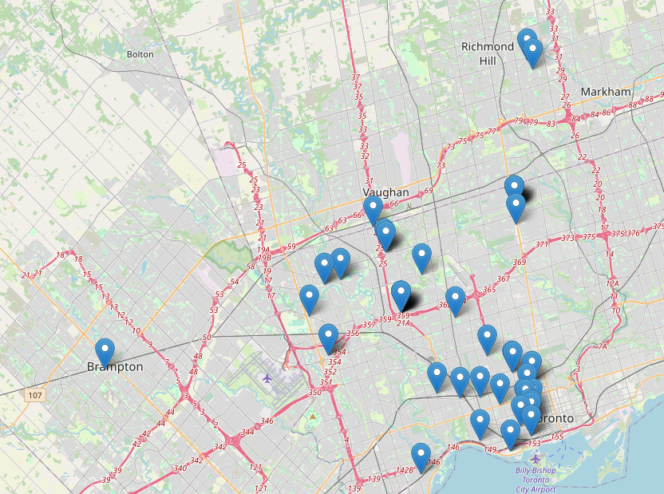
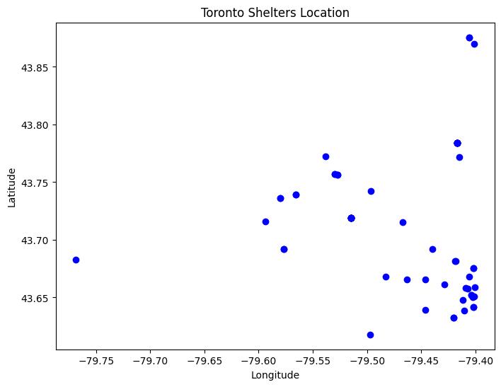
1. Understanding Shelter Geography
Figure 6: Map of Toronto Shelter Locations
Figure 7: Longitude vs Latitude Plot of Shelter Locations
Notes:
In order to effectively cluster the shelters, we needed to understand the geography of the sheters
Here in figure 6, we see the spread of shelters across the city
To the right in figure 7, we see this same mapping of shelters plotted on a longitude vs latitude plot of shelter locations
We attempted to use two different methods to cluster the shelters

Slide 27
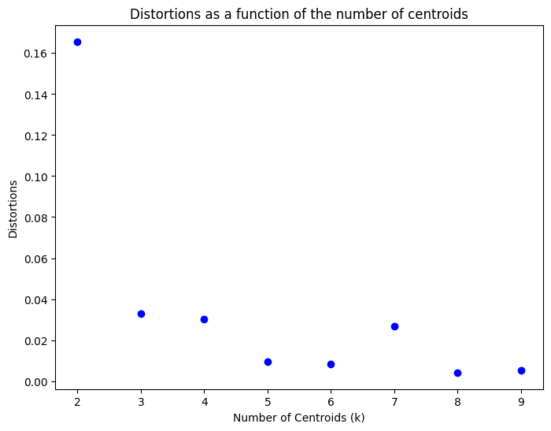
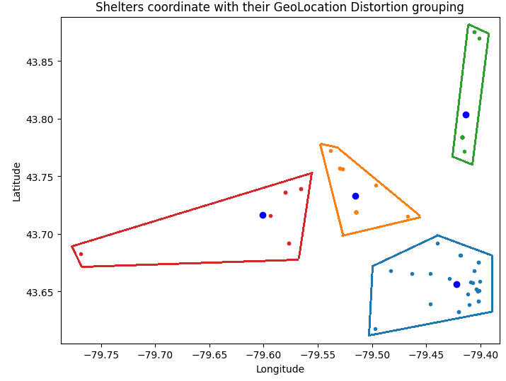
2. Determining Clusters with Distortion Analysis
Figure 8: Distortions as a Function of the Number of Centroids
Figure 9: Plot of Shelter Locations and Resulting Groupings
Notes:
First, we used distortion analysis
This analysis told us to use four centroids
We then plotted these four centroids on the longitude latitude plot and colour coded the shelters that correspond to each centroid
Although it is difficult to see, you can see that these five red shelters correspond to this centroid, these blue ones correspond to this centroid, and so on

Slide 28
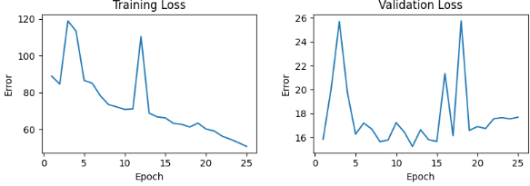
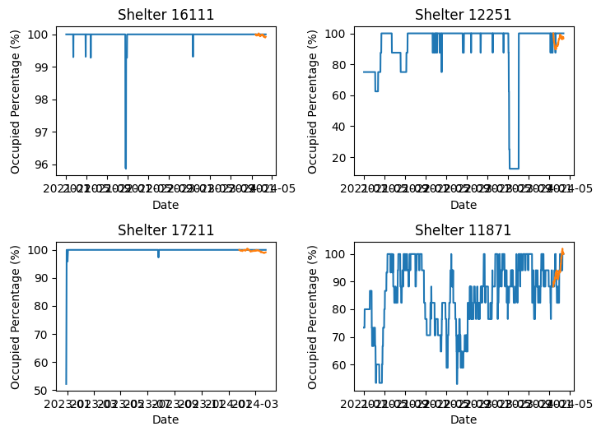
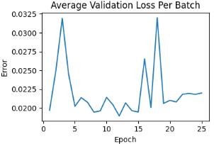
2. Model Training with Distortion Analysis
Figure 10: Training and Validation Loss
Figure 11: Model Prediction on Random Shelters
Notes:
When training the model using this clustering, we found that the results were not as good as we had hoped
As a result, we decided to explore another method

Slide 29
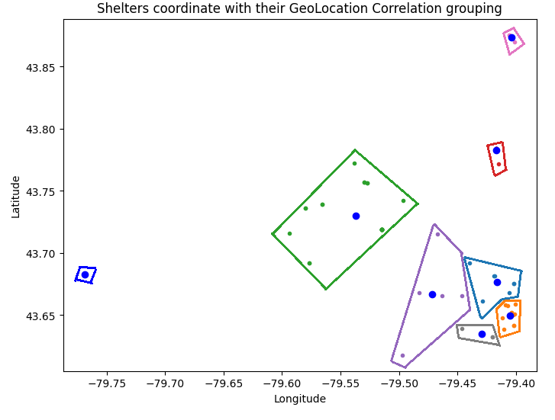
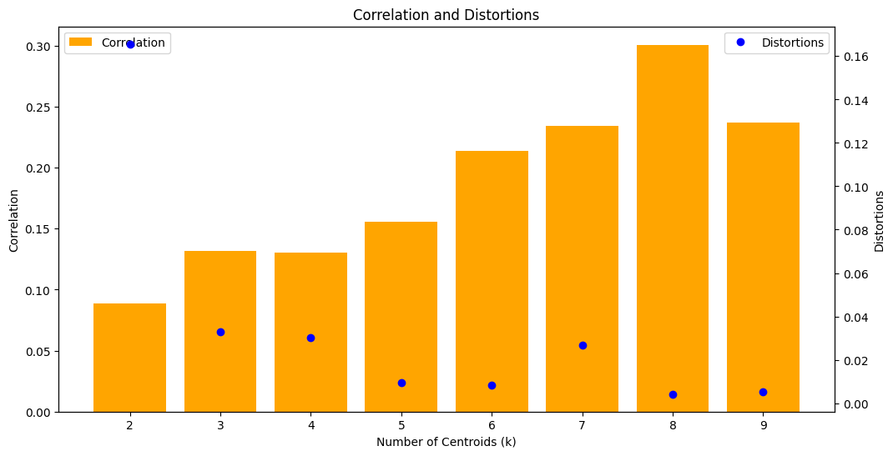
3. Determining Clusters with Correlation Analysis
Figure 12: Plot of Correlation vs Number of Centroids
Figure 13: Plot of Shelter Locations and Resulting Centroids
Notes:
Next, we explored determining the clusters with correlation analysis
This method of analysis determined that we should us 8 clusters, as seen in figure 10
Like with distortion analysis, we visualized these clusters on the longitude and latitude plot as seen in figure 11

Slide 30
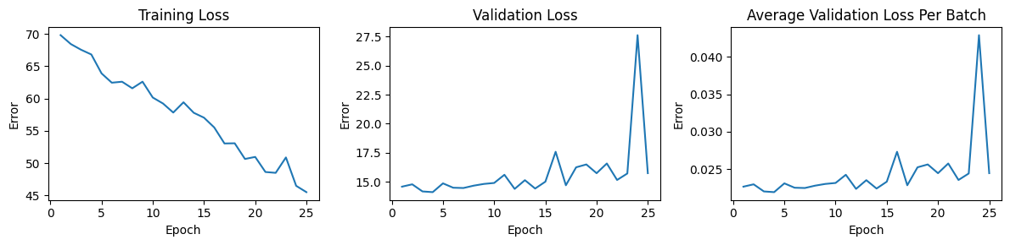
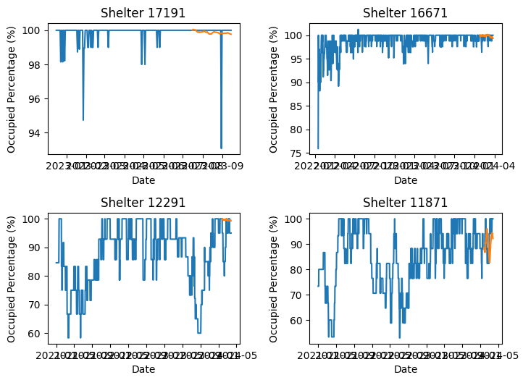
3. Model Training with Correlation Analysis
Figure 14: Training and Validation Loss
Figure 15: Model Prediction on Random Shelters
Notes:
The model training when using correlation analysis was better than with distortion analysis, so we decided to select 8 clusters for our final model

Slide 31
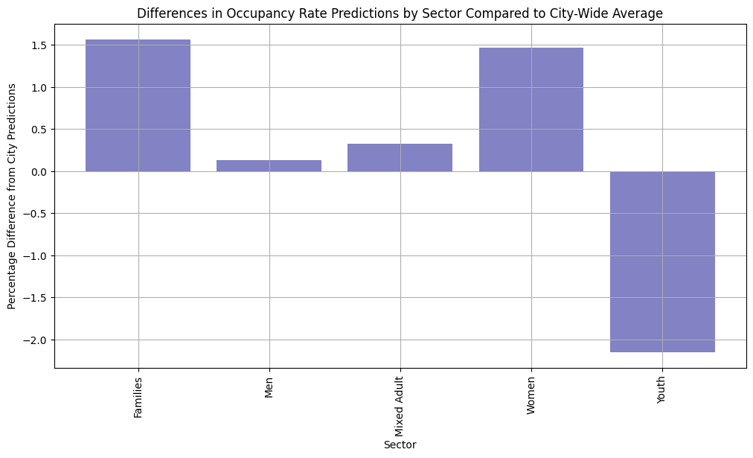
Incorporating Feature Occupancy Differences
Initial correlation analysis highlighted trends in data linked to features that were not included in LSTM
Decided to explore this further and understand how it could be incorporated into our LSTM Model
Figure 16: Plot of Average Difference Between City Average and Sector Average
Notes:
Nida
Recalling our earlier slide on data analysis, our initial correlation analysis highlighted trends in the data that were linked to features that we had not specifically explored in our LSTM
As a result, once the LSTM was built we decided to explore how we might be able to adjust these generic predictions based on the attributes of individual shelters
In the chart on the right here, we plotted the average difference in occupancy sector by shelter compared to the city-average → here you can see that family shelters are typically around 1.5% more occupied while youth shelters are 2% less occupied
After testing out this adjustment idea on our baseline model and seeing very favourable results, we decided to incorporate it into our final model design

Slide 32

Results
Notes:
Nida

Slide 33
Model Accuracy
Notes:
Nida

Slide 34
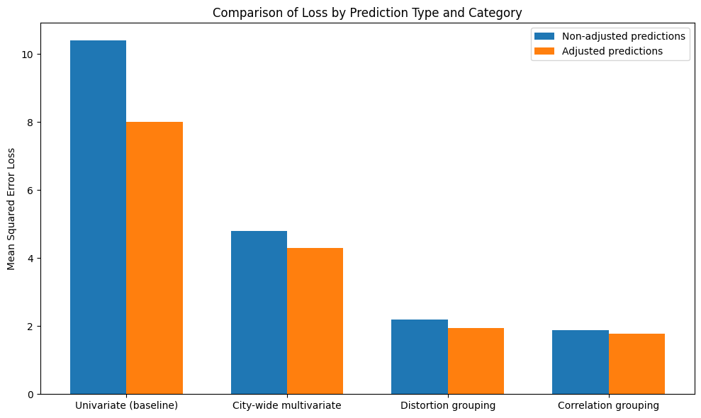
Model Accuracy: Adjusted vs. Non-adjusted
Figure 17: Mean Squared Error for Different Models
Notes:
Nida

Slide 35
Performance Compared to Baseline Models
Random Forest Regression
Root Mean Squared Error: 7.04
Mean Absolute Error: 2.59
Adjusted Geospatial Multivariate LSTM
Distortions Grouping:
Root Mean Squared Error: 1.88
Mean Absolute Error: 2.22
Correlation Grouping:
Root Mean Squared Error: 1.88
Mean Absolute Error: 1.96
Autoregressive Model
Root Mean Squared Error: 4.12
Mean Absolute Error: 16.96
Prophet (5-Day Horizon)
Root Mean Squared Error: 13.66
Mean Absolute Error: 13.44
Notes:
Nida

Slide 36
Final Product

Slide 37
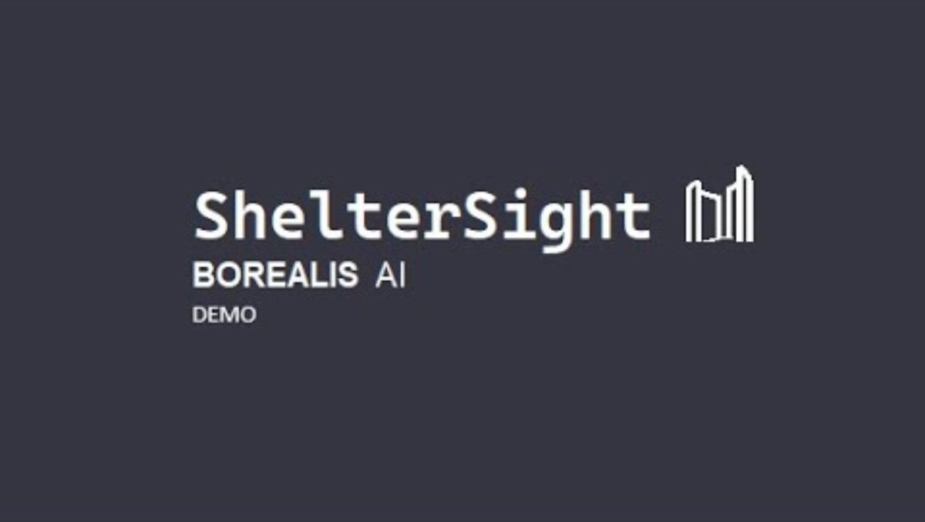

Slide 38

Discussion
Notes:
India

Slide 39
Accomplishments and Learnings
Application of Academic Knowledge
Advancing Technical Skills
Successfully transitioned theoretical knowledge from an academic setting to solve real-life challenges.
Gained experience in specifically in building and tuning LSTM models for time-series forecasting.
Notes:
India
Application of Academic Knowledge: Successfully transitioned theoretical knowledge from an academic setting to solve real-life challenges by implementing advanced machine learning techniques—such as LSTM networks and clustering algorithms—to enhance operational efficiency and decision-making in Toronto's homeless shelter system. This experience underscored the practical value of academic learning in addressing pressing societal issues.
Advancement of Technical Skills: Gained in-depth expertise in advanced machine learning techniques, specifically in building and tuning LSTM models for time-series forecasting.

Slide 40
Future Discussions
Geographic Expansion
Scale the model to other cities and regions, adapting the approach to different urban environments and regulatory contexts to widen the impact of the research
Real-Time Implementation
Develop a real-time forecasting system that dynamically updates predictions based on live data stream
Impact Analysis
Conduct longitudinal studies to measure the long-term impact of optimized shelter operations on homelessness alleviation
Notes:
India

Slide 41

Conclusion
Notes:
India

Slide 42

Questions
Notes:
India

Slide 43
Thank You

